Slide 1

IEP Process and Behavioral Treatment and Supports
Carolyn T. Bruey, Psy.D., BCBA
Licensed Psychologist, Board Certified Behavior Analyst

Slide 2
TODAY’S GOALS
Review various state and federal regulations mandated within the education system to enhance your understanding of what school systems are, and are not, mandated to provide.
Provide guidance as to how to read and understand educational documents, especially in terms of how the IEP documents behavior treatment plans/goals.

Slide 3
FIRST,
A PERSONAL PERSPECTIVE…
Notes:
20 years as a private clinician before joining IU13 15 years ago.
Less aware than I should have been in regards to educational system, regulations, etc.
“Oh, but she’s getting much better!”

Slide 4
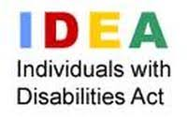
Special Educational Federal Regulations
INDIVIDUALS WITH DISABILTIES EDUCATION ACT (IDEA)
  Guarantees FAPE (Free Appropriate Public Education to eligible children with disabilities throughout the USA)
  IDEA also governs how states and public agencies provide early intervention, special education, and related services to infants, toddlers, and school-age children
  Prior to federal education regulation, most children with disabilities did not receive any formal education

Slide 5
14 DISABILITIES INCLUDED IN IDEA
Specific Learning Disability (most common IDEA identification)
Other Health Impairment
Autism Spectrum Disorder
Speech or Language Impairment
Visual Impairment (Includes Blindness)
Deafness
Hearing Impairment

Slide 6
14 DISABILITIES INCLUDED IN IDEA (Cont.)
Deaf-Blindness
Emotional Disturbance
Orthopedic Impairment
Intellectual Disability
Traumatic Brain Injury
Multiple Disabilities
Developmental Delay (only for Early Intervention or Kindergarten)
Let’s look at the definitions of each IDEA disability

Slide 7
Autism means a developmental disability significantly affecting verbal and nonverbal communication and social interaction, generally evident before age three, that adversely affects a child’s educational performance. Other characteristics often associated with autism are engaging in repetitive activities and stereotyped movements, resistance to environmental change or change in daily routines, and unusual responses to sensory experiences. The term autism does not apply if the child’s educational performance is adversely affected primarily because the child has an emotional disturbance, as defined in #5 below. A child who shows the characteristics of autism after age 3 could be diagnosed as having autism if the criteria above are satisfied.

Slide 8
Intellectual Disability means significantly subaverage general intellectual functioning, existing concurrently [at the same time] with deficits in adaptive behavior and manifested during the developmental period, that adversely affects a child’s educational performance.
Traumatic Brain Injury means an acquired injury to the brain caused by an external physical force, resulting in total or partial functional disability or psychosocial impairment, or both, that adversely affects a child’s educational performance. The term applies to open or closed head injuries resulting in impairments in one or more areas, such as cognition; language; memory; attention; reasoning; abstract thinking; judgment; problem-solving; sensory, perceptual, and motor abilities; psychosocial behavior; physical functions; information processing; and speech. The term does not apply to brain injuries that are congenital or degenerative, or to brain injuries induced by birth trauma.

Slide 9
Emotional Disturbance means a condition exhibiting one or more of the following characteristics over a long period of time and to a marked degree that adversely affects a child’s educational performance:
(a) An inability to learn that cannot be explained by intellectual, sensory, or health factors.
(b) An inability to build or maintain satisfactory interpersonal relationships with peers and teachers.
(c) Inappropriate types of behavior or feelings under normal circumstances.
(d) A general pervasive mood of unhappiness or depression.
(e) A tendency to develop physical symptoms or fears associated with personal or school problems.
The term includes schizophrenia. The term does not apply to children who are socially maladjusted, unless it is determined that they have an emotional disturbance.

Slide 10
Specific Learning Disability means a disorder in one or more of the basic psychological processes involved in understanding or in using language, spoken or written, that may manifest itself in the imperfect ability to listen, think, speak, read, write, spell, or to do mathematical calculations. The term includes such conditions as perceptual disabilities, brain injury, minimal brain dysfunction, dyslexia, and developmental aphasia. The term does not include learning problems that are primarily the result of visual, hearing, or motor disabilities; of intellectual disability; of emotional disturbance; or of environmental, cultural, or economic disadvantage.
Other Health Impairment means having limited strength, vitality, or alertness, including a heightened alertness to environmental stimuli, that results in limited alertness with respect to the educational environment, that—
(a) is due to chronic or acute health problems such as asthma, attention deficit disorder or attention deficit hyperactivity disorder, diabetes, epilepsy, a heart condition, hemophilia, lead poisoning, leukemia, nephritis, rheumatic fever, sickle cell anemia, and Tourette syndrome; and
(b) adversely affects a child’s educational performance.

Slide 11
Speech or Language Impairment means a communication disorder such as stuttering, impaired articulation, a language impairment, or a voice impairment that adversely affects a child’s educational performance.
Visual Impairment Including Blindness means an impairment in vision that, even with correction, adversely affects a child’s educational performance. The term includes both partial sight and blindness.
Deafness means a hearing impairment so severe that a child is impaired in processing linguistic information through hearing, with or without amplification, that adversely affects a child’s educational performance.
Hearing Impairment means an impairment in hearing, whether permanent or fluctuating, that adversely affects a child’s educational performance but is not included under the definition of “deafness.”

Slide 12
Deaf-Blindness means concomitant [simultaneous] hearing and visual impairments, the combination of which causes such severe communication and other developmental and educational needs that they cannot be accommodated in special education programs solely for children with deafness or children with blindness.
Orthopedic Impairment means a severe orthopedic impairment that adversely affects a child’s educational performance. The term includes impairments caused by a congenital anomaly, impairments caused by disease (e.g., poliomyelitis, bone tuberculosis), and impairments from other causes (e.g., cerebral palsy, amputations, and fractures or burns that cause contractures).
Developmental Delay for children from birth to age three (under IDEA Part C) and children from ages three through nine (under IDEA Part B), the term developmental delay, as defined by each State, means a delay in one or more of the following areas: physical development; cognitive development; communication; social or emotional development; or adaptive [behavioral] development.

Slide 13
Multiple Disabilities means concomitant [simultaneous] impairments (such as intellectual disability-blindness, intellectual disability-orthopedic impairment, etc.), the combination of which causes such severe educational needs that they cannot be accommodated in a special education program solely for one of the impairments. The term does not include deaf-blindness.

Slide 14

GROUP DISCUSSION
Think of the members that you’ve worked with who have IEPs
  What are their IDEA disabilities?
  What were their Mental Health diagnoses?
  How did the diagnoses “match up”?
  How could the different diagnostic systems inadvertently cause confusion when community agency staff (e.g., IBHS, physicians, etc.) work with schools?

Slide 15

PENNSYLVANIA SPECIAL EDUCATION
STATE REGULATIONS
PA Chapter 14: PA Special Education Law
Spells out regulated mandates regarding…
  Special education rights for students attending public schools
  Evaluations
  Reevaluations
  Behavioral Supports/Use of Restraints
  Etc.

Slide 16
“ACCESS TO EDUCATION”
Schools are only mandated to provide special education services if the child’s mental health or behavioral concerns prohibit “access to education”.
Two-pronged question for every Initial Evaluation or Reevaluation:
  Does the student have a disability as identified by IDEA?
  Does the child need specially designed instruction?
  The answer to BOTH questions must be “yes” for the child to be eligible for an IEP.

Slide 17
UNDERSTANDING SPECIAL EDUCATION PROCESSES AND TIMELINES

Slide 18
SCHOOL STAFF’S ROLES AND RESPONSIBILITIES
School Psychologist’s role
  Primary goal: Conduct Initial Evaluations/Reevaluations
    Follows the bi or triannual evaluation timelines for students identified with disabilities who need special education services (i.e., NOT to be seen as a “go to” anytime a child needs testing between these mandatory timelines)
    For Reevaluations: If the IEP team determines that “no additional testing” is required, then the school psychologist does not have to be involved (district by district decision)
  Sometimes conducts Functional Behavior Assessments (if the district does not have a Behavior Consultant)
  Sometimes facilitates social skills groups, etc.
School Social Worker’s role
  Liaison with families and community agencies
  Helping families access funding, insurance, etc.
  Sometimes take the lead on truancy
School Counselor’s role
  Provides counseling regarding academics and vocational plans for the most part

Slide 19
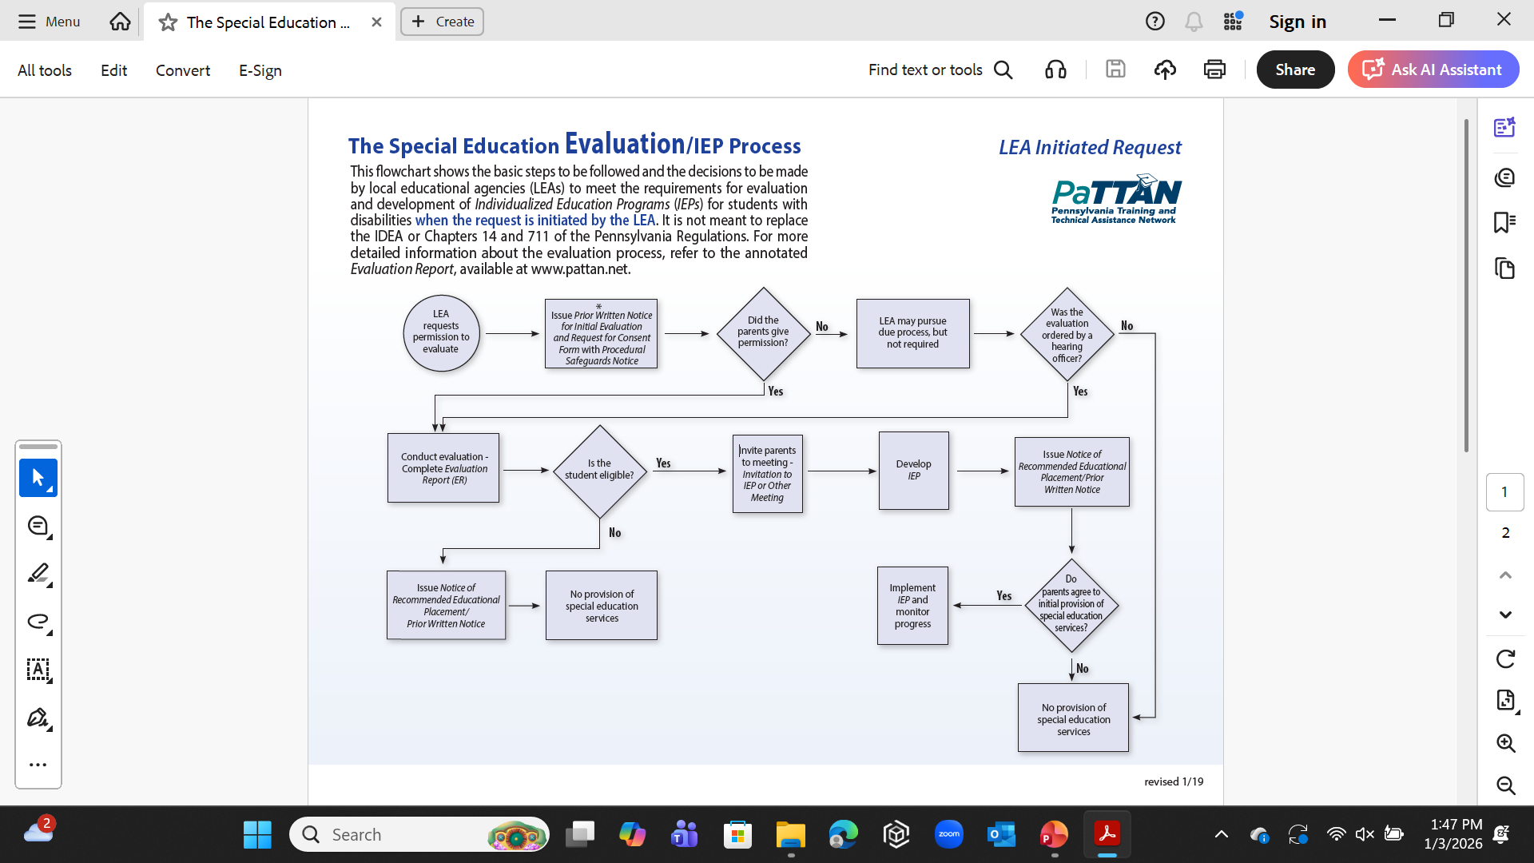
THE IEP PROCESS

Slide 20
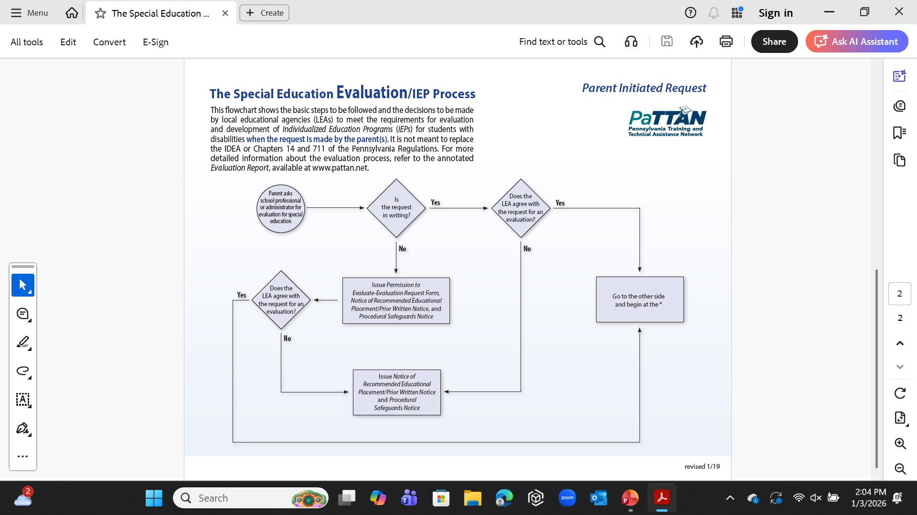

Slide 21
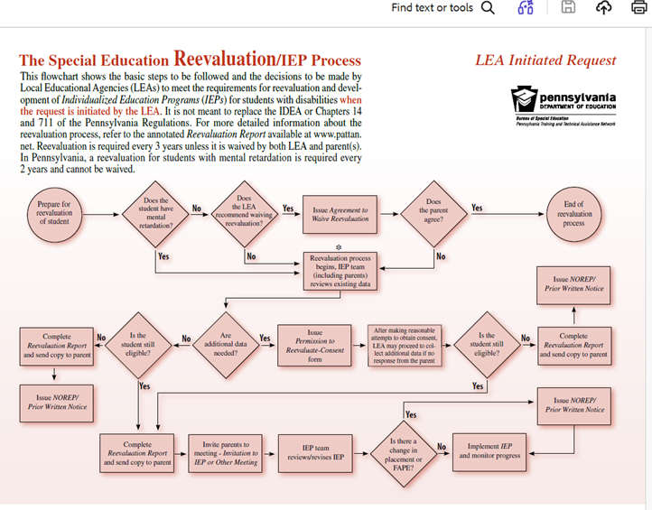

Slide 22
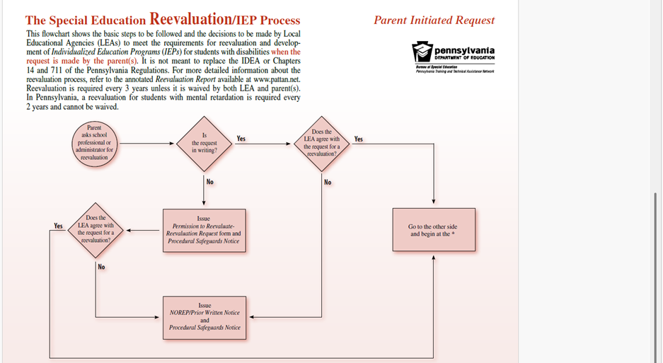

Slide 23
SPECIAL EDUCATION TIMELINES
See PDE “Special Education Timelines” booklet

Slide 24
REEVALUATION TIMELINES
Once a student has been identified as a special education student, a Reevaluation must be completed every 3 years (with the exception of students with the IDEA disability of Intellectual Disability who need to have a new Reevaluation every 2 years).
Outside agencies asking the school to complete a Reevaluation outside of these regulated timeliness (e.g., primarily to prove eligibility for county case management) can be tricky.

Slide 25
HOW TO INTERPRET
SCHOOL DOCUMENTS

Slide 26
ANNOTATED DOCUMENTS FROM PATTAN
PaTTAN: Pennsylvania Training and Technical Assistance Network
  (see PaTTAN.net)
ANNOTATED EVALUATION REPORT FORM

Slide 27
ANNOTATED DOCUMENTS FROM PATTAN
PaTTAN: Pennsylvania Training and Technical Assistance Network
  (see PaTTAN.net)
ANNOTATED REEVALUATION REPORT

Slide 28
ANNOTATED DOCUMENTS FROM PATTAN
PaTTAN: Pennsylvania Training and Technical Assistance Network
  (see PaTTAN.net)
ANNOTATED INDIVIDUALIZED EDUCATION PROGRAM (IEP)

Slide 29
THE “BEHAVIOR” BOX MUST BE CHECKED IN ORDER FOR THE STUDENT TO RECEIVE A PBSP
Does the student exhibit behaviors that impede his/her learning or that of others?
☐Yes – The IEP team must develop a Positive Behavior Support Plan that is based on a functional assessment of behavior and that utilizes positive behavior techniques. Results of the functional assessment of behavior may be listed in the Present Levels section of the IEP with a clear measurable plan to address the behavior in the Goals and Specially Designed Instruction sections of the IEP or in the Positive Behavior Support Plan if this is a separate document that is attached to the IEP. A Positive Behavior Support Plan and a Functional Behavioral Assessment form are available atwww.pattan.net

Slide 30
ANNOTATED DOCUMENTS FROM PATTAN
PaTTAN: Pennsylvania Training and Technical Assistance Network
  (see PaTTAN.net)
ANNOTATED POSTIVE BEHAVIOR SUPPORT PLAN

Slide 31
WHERE TO FIND THE FBA AND PBSP IN THE IEP?
Varies across school districts
Some districts and IU13 cut/paste the PATTAN PBSP template into their IEPs
Other districts incorporate various aspects of the PBSP into different sections of the IEP (e.g., FBA in the “Present Levels of Performance”, behavioral strategies in the Specially Designed Instruction” section, etc.)
It is risky to have a separate PBSP merely attached to the IEP.

Slide 32
GROUP DISCUSSION
  How knowledgeable are you about each of your member’s Evaluation/Reevaluation Report and IEP?
  Which sections of these documents are most important for you to read thoroughly?
  How does an increased understanding of these types of educational documents enhance your understanding of your members?

Slide 33

THANKS!

